Slide 1

Department of FOT
01CE0101 - Computer Programming
Unit - 3
Control Structure and Looping

Slide 2
Decision making statements
Decision making statements in programming languages decides the direction of flow of program execution.
Decision making statements are:
if statement
if..else statements
else..if ladder
nested if statements

Slide 3
If statement
If statement is the simplest decision-making statement.
It is used to decide whether a certain statement or block of statements will be executed, if a certain condition is true then a block of statement is executed otherwise not.

Slide 4
If statement
Syntax:
if(condition)
{
Statement – 1;
Statement – 2;
.
.
Statement – n;
}
Statement – n can be a statement or a set of statements, and if the test expression is evaluated to true, the statement block will get executed, or it will get skipped.

Slide 5
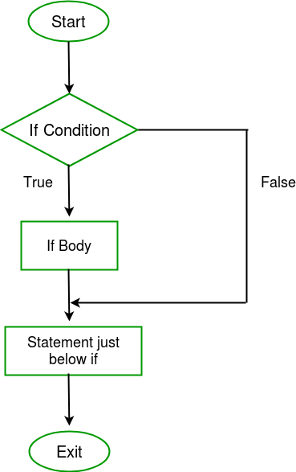
Flow start

Slide 6
How to use if statements
The condition is always enclosed within a pair of parenthesis i.e. ( )
The conditional statement should not terminated with Semi-colons ( ;)
The Statements following the “if”-statement are normally enclosed in Curly Braces {}.
The Curly Braces indicates the scope of “if” statement. The default scope is one statement. But it is good practice to use curly braces even with a single statement.
The statement block may be a single statement or a group of statements.

Slide 7
If statement - Example
Check the biggest number
#include<stdio.h>
int main()
{
int a , b ;
printf("Enter a number :");
scanf("%d%d", &a,&b);
if (b> a)
{
printf("b is greater");
}
return 0;
}

Slide 8
If else statement
In this decision control statement, we have two block of statements. If condition results true then if block gets executed else statements inside else block executes. else cannot exist without if statement
Syntax:
if(expression)
{
statement block -1;
}
Else // their would be no condition in else at anyhow
{
statement block - 2;
}

Slide 9
Example
Check whether the given number is positive or negative
#include<stdio.h>
int main()
{
int num;
printf("Enter a number :");
scanf("%d", &num);
if (num >= 0)
{
printf("%d is a positive number \n", num);
}
else
{
printf("%d is a negative number \n", num);
}
return 0;
}

Slide 10
else-if ladder statement or if else if
if(condition1)
{
//statement1
}
else if(condition2)
{
//statement2
}
else if(condition3 )
{
//statement3
}
else
// default statement

Slide 11
else-if ladder statement or if else if
#include<stdio.h>
int main()
{
int a, b;
printf("Please enter the value for a:");
scanf("%d", &a);
printf("\nPlease enter the value for b:");
scanf("%d", &b);
if (a > b)
{
printf("\n a is greater than b");
}
else if (b > a)
{
printf("\n b is greater than a");
}
else
{
printf("\n Both are equal");
}
return 0;
}

Slide 12
Nested if....else statement
When an if else statement is present inside the body of another “if” or “else” then this is called nested if else.
In C programming, control statements like as if can be nested, that means we can write one within another.
If outer if statement fails, then the compiler skips the entire block irrespective of their inner if statement.

Slide 13
Nested if....else statement
Syntax:
if( condition) { if( expression1 ) { //statement1 } else { //statement2 } } else { // statement3 }

Slide 14
Example
#include <stdio.h>
int main( )
{
int a, b, c;
printf("Please enter three numbers: ");
scanf("%d%d%d",&a, &b, &c);
if(a > b)
{
if(a > c)
{
printf("a is the greatest among the three");
}
else
{
printf("c is the greatest among the three");
}
}
else
{
if(b > c)
{
printf("b is the greatest among the three");
}
else
{
printf("c is the greatest among the three");
}
}
}

Slide 15
Switch Case statements
It is a built – in multiway decision statement.
The switch statement in C is an alternate to if-else-if ladder statement which allows us to execute multiple operations for the different possible values of a single variable called switch variable.
Here, We can define various statements in the multiple cases for the different values of a single variable.

Slide 16
Switch Case statements
It tests the value of a variable and compares it with multiple cases. Once the case match is found, a block of statements associated with that particular case is executed.
Each case in a block of a switch has a different name/number which is referred to as an identifier. The value provided by the user is compared with all the cases inside the switch block until the match is found.
If a case match is NOT found, then the default statement is executed, and the control goes out of the switch block.

Slide 17
Switch Case statements
Syntax:
switch( expression )
{
case value-1:
Block-1;
Break;
case value-2:
Block-2;
Break;
case value-n:
Block-n;
Break;
default:
Block-1;
Break;
}
Statement-x;

Slide 18
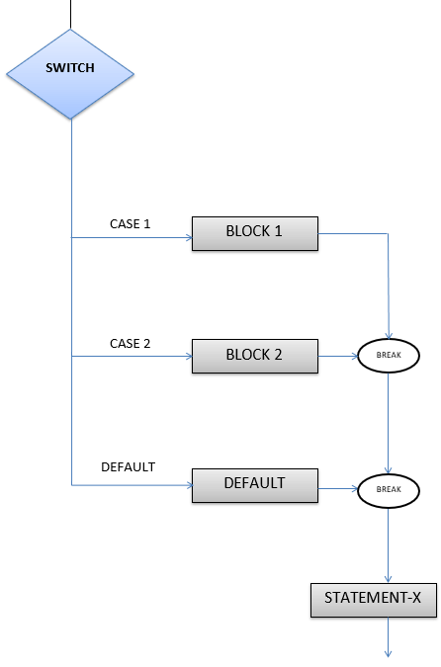
Switch Case statements

Slide 19
Switch Case statements
Rules :
The switch expression must be of an integer or character type.
The case value must be an integer or character constant.
Case labels must be constants and unique.
Case labels must end with a colon ( : )
A break keyword must be present in each case.
There can be only one default label.
Default case is executed when none of the mentioned case matches the switch expression.
The default case can be placed anywhere in the switch case. Even if we don't include the default case, switch statement works.

Slide 20
Switch Case statements
#include <stdio.h>
int main()
{
int x ;
printf (“Enter the value for x”);
scanf(“%d”,&x);
switch (x)
{
case 1:
printf("Choice is 1");
break;
case 2:
printf("Choice is 2");
break;
case 3:
printf("Choice is 3");
break;
default:
printf("Choice other than 1, 2 and 3");
break;
}
return 0;
}

Slide 21
Conditional or Ternary Operator (?:) operator
The conditional operator is kind of similar to the if-else statement as it does follow the same algorithm as of if-else statement
But the conditional operator takes less space and helps to write the if-else statements in the shortest way possible.
Syntax:
The conditional operator is of the form
variable = Expression1 ? Expression2 : Expression3

Slide 22
Conditional or Ternary Operator (?:) operator
It can be visualized into if-else statement as:
if(Expression1)
{
variable = Expression2;
}
else
{
variable = Expression3;
}

Slide 23
Conditional or Ternary Operator (?:) operator
Since the Conditional Operator ‘?:’ takes three operands to work, hence they are also called ternary operators.
Working: Here, Expression1 is the condition to be evaluated. If the condition(Expression1) is True then Expression2 will be executed and the result will be returned. Otherwise, if the condition(Expression1) is false then Expression3 will be executed and the result will be returned.
condition ? expression_if_true : xpression_if_false;

Slide 24
Example
// C program to find largest among two numbers using ternary operator
#include <stdio.h>
int main()
{
int m = 5, n = 4;
(m > n) ? printf("m is greater than n that is %d>%d”, m, n) :
printf("n is greater than m that is %d>%d”, n, m);
return 0;
}

Slide 25
Looping
Loops are the technique to repeat set of statements until given condition is true.
Depending upon the position of a control statement in a program, looping in C is classified into two types:
1. Entry controlled loop
2. Exit controlled loop

Slide 26
Entry controlled and Exit controlled loops
Entry Control Loop the test condition is checked first and if that condition is true then the block of the statement will be executed.
Exit control loop first executes the body of the loop and checks condition at last.
The c programming language has three types of loops –
while loop,
do-while loop
for loop
These loops controlled either at the Entry level or at the Exit level

Slide 27
Differences
Entry Control Loop | Exit Control Loop
Entry control loop checks condition first and then body of the loop will be executed. | The exit control loop first executes the body of the loop and checks condition at last.
The body of the loop may or may not be executed at all. | The body of the loop will be executed at least once because the condition is checked at last
for, while are an example of an entry control loop | Do…while is an example of an exit control loop.

Slide 28
for loop
The initial value of the for loop is performed only once.
The condition that tests and compares the counter to a fixed value after each iteration, stopping the for loop when false is returned.
The increment/decrement increases (or decreases) the counter by a set value.

Slide 29
for loop
A for loop is a more efficient loop structure in 'C' programming.
Syntax:
for (initial value; condition; increment or decrement )
{
// statements;
}

Slide 30
Example
Print the numbers from 1 to 10
#include<stdio.h>
int main()
{
int x;
for(x=1; x<=10; x++)
{
printf("%d\n", x);
}
return 0;
}

Slide 31
while loop
A while loop is the most straightforward looping structure. It is an entry-controlled loop.
Syntax :
while (condition)
{
//statements;
}
In while loop, a condition is evaluated before processing a body of the loop.

Slide 32
while loop
If a condition is true then and only then the body of a loop is executed.
After the body of a loop is executed then control again goes back at the beginning, and the condition is checked if it is true, the same process is executed until the condition becomes false.
Once the condition becomes false, the control goes out of the loop.

Slide 33
while loop
After exiting the loop, the control goes to the statements which are immediately after the loop.
The body of a loop can contain more than one statement. If it contains only one statement, then the curly braces are not compulsory.
It is a good practice though to use the curly braces even we have a single statement in the body.
In while loop, if the condition is not true, then the body of a loop will not be executed, not even once.

Slide 34
Example
Print series of numbers from 1 to 10 using a while loop
#include<stdio.h>
int main()
{
int num=1;
while(num<=10)
{
printf("%d\n",num);
num++;
}
return 0;
}

Slide 35
do while loop
A do...while loop in C is similar to the while loop except that the condition is always executed after the body of a loop. It is also called an exit-controlled loop.
Syntax:
do
{
//statements;
} while (expression);

Slide 36
do while loop
In the do-while loop, the body of a loop is always executed at least once. After the body is executed, then it checks the condition.
If the condition is true, then it will again execute the body of a loop otherwise control is transferred out of the loop

Slide 37
Example
Print a table of number 2
#include<stdio.h>
int main()
{
int num=1;
do
{
printf("%d\n",2*num);
num++ ;
}while(num<=10);
return 0;
}
Output:
2
4
6
8
10
12
14
16
18
20

Slide 38
Concept of jump
Jump statements alter the normal execution path of a program.
Jump statements are used when we want to skip some statements inside loop or terminate the loop immediately when some condition becomes true.
There are 4 jump statements
Break
Continue
Goto
Return

Slide 39
Break statement
It is a keyword which is used to terminate the loop (or) exit from the block.
The control jumps to next statement after the loop (or) block.
break is used with for, while, do-while and switch statement.
When break is used in nested loops then, only the innermost loop is terminated.

Slide 40
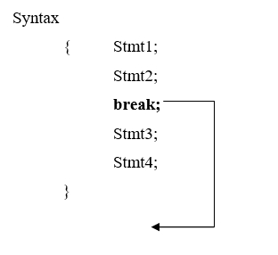
Break statement
The syntax for break statement is as follows,

Slide 41
Example
// Example of Break Statement
#include <stdio.h>
int main()
{
int i;
for (i = 1; i <= 15; i++)
{
printf("%d\n", i);
if (i == 10)
break;
}
return 0;
}

Slide 42
continue statement
The continue statement is used to bring the program control to the beginning of the loop.
The continue statement skips some lines of code inside the loop and continues with the next iteration.
It is mainly used for a condition so that we can skip some code for a particular condition.

Slide 43
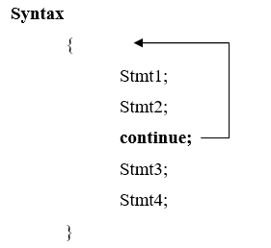
continue statement
The syntax for the continue statement is as follows,

Slide 44
Example
// Example of Continue Statement
#include <stdio.h>
Int main( )
{
int i;
for (i=1; i<=5; i++)
{
if (i==2)
continue;
printf("%d", i)
}
}

Slide 45
goto statement
The goto statement is a jump statement which is sometimes also referred to as unconditional jump statement.
The goto statement can be used to jump from anywhere to anywhere within a function.
goto is used to transfer the program control to a predefined label.
The goto statment can be used to repeat some part of the code for a particular condition.

Slide 46
goto statement
Syntax:
goto label;
..
..
label: statement;
NOTE − Use of goto statement is highly discouraged in any programming language because it makes difficult to trace the control flow of a program, making the program hard to understand and hard to modify.
Any program that uses a goto can be rewritten to avoid them.

Slide 47
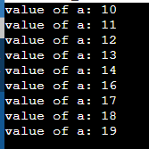
Example
#include <stdio.h>
int main ()
{
int a = 10;
LOOP:
do
{
if( a == 15)
{
a = a + 1;
goto LOOP;
}
printf("value of a: %d\n", a);
a++;
}while( a < 20 );
return 0;
}

Slide 48
Return statement
Return jump statement is usually used at the end of a function to end or terminate it with or without a value.
It takes the control from the calling function back to the main function(main function itself can also have a return).
An important point to be taken into consideration is that return can only be used in functions that is declared with a return type such as int, float, double, char, etc.

Slide 49
Return statement
The functions declared with void type does not return any value. Also, the function returns the value that belongs to the same data type as it is declared.
The return is a jump statement. When the return statement is executed in a function, then it terminates the execution of the function and returns control to its caller function.
Syntax:
return expression;

Slide 50
Example 1
#include<stdio.h>
int main()
{
// Calling print
Printing();
return 0;
}
void Printing()
{
printf("Welcome to MU");
}

Slide 51

Example 2
#include <stdio.h>
// function to calculate sum
int SUM(int a, int b)
{
int s1 = a + b;
// method using the return
// statement to return a value
return s1;
}
int main()
{
int num1 = 10;
int num2 = 10;
int sum_of = SUM(num1, num2);
printf("The sum is %d", sum_of);
return 0;
}

Slide 52
Thank You!!

